Slide 1
Java 11 & 17 Features

Slide 2
Java 11 Features
Running Java Files
New String Methods
Nest Based Access Control
New File Methods
Collection to an Array
HTTP Client
Local-Variable Syntax for Lambda
Dynamic Class-File Constants
Improved Aarch64 Intrinsics
Epsilon Garbage Collector
Java Flight Recorder

Slide 3
Running Java Files
Execute Java File Without Compilation
From Java 11, Java provides flexibility to run Java code without compilation. It means we can execute Java code in a single step.
Before Java 11, if we execute Java file then first, we need to compile the code and then run the code. This whole process requires two major steps:
Compile Java code
Run Java code
To compile the code, we use javac MyFirstProgram.java command. and
To run this file, we use java MyFirstProgram command in the terminal (cmd in windows).
But if we are working with Java 11 then we don't need to follow these two steps. Just use single command java java_file.java and it will execute the file by producing the desired result.
Note: This feature is applicable if we have a single file of source code. It means all the code is in a single file, with no external dependency.
Notes:
For Reference https://www.studytonight.com/java-examples/java-11-new-features

Slide 4
New String Methods
isBlank() - this method is used to check whether a string is blank or not. Empty strings and strings with just whitespace are considered blank.
lines() - this method splits a string using line terminators and returns a stream.
repeat() - this method is used to duplicate or repeat a string.
strip(), stripLeading(), stripTrailing() - These methods are used to remove whitespace from the strings. They are very similar to the existing trim() method, but provide Unicode support.
Notes:
For Reference https://www.studytonight.com/java-examples/java-11-new-features

Slide 5
Nest Based Access Control
Previous Java versions allowed access of private members to nested classes(nestmates), but we cannot use them with the Reflection API. Java 11 no longer uses bridge methods and provides the getNestHost(), getNestMembers(), and isNestmatOf() methods for the Reflection API.
Notes:
For Reference https://www.studytonight.com/java-examples/java-11-new-features

Slide 6
New File Methods
Java 11 makes it a lot easier to read and write strings.
The readString() and writeString() static methods are added to the Files class for this purpose.
Notes:
For Reference https://www.studytonight.com/java-examples/java-11-new-features

Slide 7
Collection to an Array
The new default toArray() method is used to easily convert a collection to an array of the correct type.
Notes:
For Reference https://www.studytonight.com/java-examples/java-11-new-features

Slide 8
The not() Method
A static not() method has been added to the Predicate interface in Java 11.
As the name suggests, this method is used to negate a Predicate. The not() method can also be used with method references.
Notes:
For Reference https://www.studytonight.com/java-examples/java-11-new-features
Let's use this method to create two predicates that perform opposite tasks.

Slide 9
HTTP Client
The HTTP Client API was first introduced in Java 9 and was updated in Java 10.
It is offered as a standard feature in Java 11 version.
The new API has better performance and is compatible with both HTTP/1.1 and HTTP/2.
The API also provides support for WebSockets.
Notes:
For Reference https://www.studytonight.com/java-examples/java-11-new-features

Slide 10
Local-Variable Syntax for Lambda
Java 11 adds the support for Local-Variable syntax for lambda expressions.
Lambdas can infer the type, but using the var keyword allows us to use annotations like @NotNull or @Nullable with the parameters.
(@NotNull var str) -> "$" + str
Notes:
For Reference https://www.studytonight.com/java-examples/java-11-new-features

Slide 11
Dynamic Class-File Constants
In Java 11, the Java Class-File format supports a new constant pool form called the CONSTANT_Dynamic.
This will delegate creation to a bootstrap method.
This was introduced to reduce the cost of creating new forms of materializable class-file constants by creating a single new constant-pool form that will be parameterized with appropriate user-defined behavior.
This feature greatly enhances the performance.
Notes:
For Reference https://www.studytonight.com/java-examples/java-11-new-features

Slide 12
Improved Aarch64 Intrinsics
An Intrinsic is a function that is handled in some special way by the compiler.
They take advantage of the CPU architecture-specific assembly code to improve performance.
Java 11 improved and optimized the existing string and array intrinsic on AArch64(or ARM64) processors.
Java 11 also added new intrinsics for sin, cos, and log methods of the java.lang.Math.
Notes:
For Reference https://www.studytonight.com/java-examples/java-11-new-features

Slide 13
Epsilon Garbage Collector
Java 11 introduced a no-operations(No-Op) garbage collector called Epsilon. This is an experimental feature.
It is called a No-Op garbage collector because it will allocate memory but will never collect any garbage.
We can use it for simulating Out-Of-Memory errors.
The following are some of its use cases.
Performance testing
Memory pressure testing
VM interface testing and
Extremely short-lived jobs
Last-drop latency and throughput improvements
Use the following command to enable the Epsilon GC.
-XX:+UnlockExperimentalVMOptions -XX:+UseEpsilonGC
Notes:
For Reference https://www.studytonight.com/java-examples/java-11-new-features

Slide 14
Java Flight Recorder
Java Flight Recorder(JFR in short) is used to gather profiling data for an application.
It used to be available only for commercial uses, but it is now open-source under OpenJDK 11.
We can use it for production applications, as its overhead is minimal(below 1%).
It records the data in a JFR file, and we can use the JDK Mission Control tool to analyze the collected information.
Use the following command to start a 180 seconds JFR recording and store the data in the demo.jfr file.
-XX:StartFlightRecording=duration=180s,settings=profile,filename=demo.jfr
Notes:
For Reference https://www.studytonight.com/java-examples/java-11-new-features

Slide 15
Java 17 Features
Sealed Classes
Strongly Encapsulate JDK Internals
Add java.time.InstantSource
Hex Formatting and Parsing Utility
Context-Specific Deserialization Filters
Enhanced Pseudo-Random Number Generators
Performance
Preview and Incubator Features

Slide 16
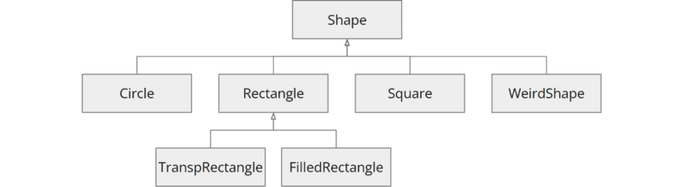
Sealed Classes
The big innovation in Java 17 (besides long-term support) is sealed classes (and interfaces).
Starting Point: Example Class Hierarchy
Source code of the example
public class Shape { ... }
public class Circle extends Shape { ... }
public class Rectangle extends Shape { ... }
public class Square extends Shape { ... }
public class WeirdShape extends Shape { ... }
public class TranspRectangle extends Rectangle { ... }
public class FilledRectangle extends Rectangle { ... }

Slide 17
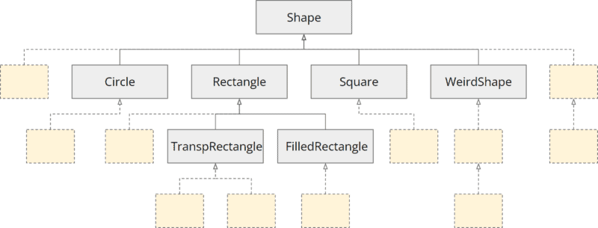
Sealed Classes
Usually, every developer can extend this class hierarchy at any place.
An extended structure could look like this (here colored the added classes light yellow):
Sealed classes example - extension possibilities without sealing
Notes:
Now, we may want to restrict the extension of our class hierarchy. For example, we might want to specify that developers may only extend the WeirdShape class.
Why would we want to do that, and how can we do it?

Slide 18
Sealed Classes
Why Restrict the Extensibility of a Class Hierarchy?
There may be several reasons why we want to restrict the free extensibility of our class hierarchy:
We want to protect the internal state of a class or a hierarchy of classes and not have it manipulated inconsistently by a child class.
We want to protect internal objects whose thread safety is guaranteed by our class or class hierarchy from being published so that foreign code cannot compromise thread safety.
We want to ensure that the Liskov substitution principle (LSP) is not violated. That is, we don't want a developer to implement a derived class that breaks the API contract of the parent class.
Notes:
Now that we know the reasons for constraining a class hierarchy, we move on to the next question: How can we do that?

Slide 19
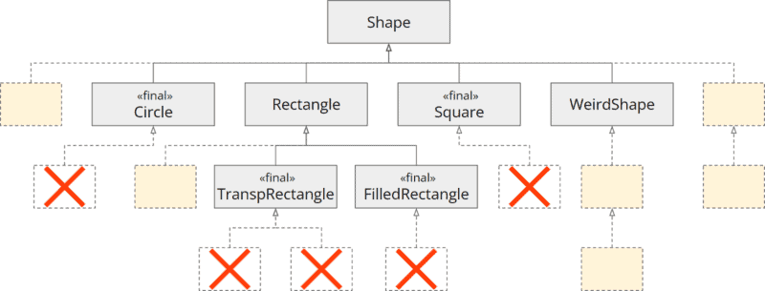
Sealing the Class Hierarchy – Step by Step
Restricting the Class Hierarchy with “final”
By marking classes as "final", we can prevent their extension in general.
A second option would be to mark a class as package-private to permit only subclasses within the same package.
However, this would have the consequence that the superclass would no longer be visible outside the package, which is undesirable in most cases.
Let's try to use "final" in our example.
We mark the classes Circle, TranspRectangle, FilledRectangle, and Square as final (remember: WeirdShape should remain the only extendable class).
This limits the extensibility of our class hierarchy, as shown in the following class diagram:

Slide 20
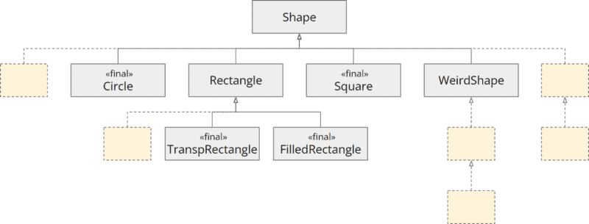
Sealing the Class Hierarchy – Step by Step
To improve clarity, here is the removed the crossed-out boxes below the final classes in the following graphic:
Restricting the class hierarchy with "final"
Notes:
This means we are on the right track, but we are still far from our goal. What now? Obviously, we can't make Shape and Rectangle final because other classes should extend them.
This is where sealed classes come in...

Slide 21
Sealing the Class Hierarchy with "sealed" and "permits"
Using "sealed types", we can implement what is called a "sealed class hierarchy".
It works as follows:
We mark the class whose subclasses we want to restrict with the sealed keyword.
Using the keyword permits, we list the allowed subclasses.
We extend the code of the Shape and Rectangle classes as follows:
public sealed class Shape permits Circle, Square, Rectangle, WeirdShape { ... }
public sealed class Rectangle extends Shape permits TranspRectangle, FilledRectangle { ... }
Notes:
With this code, we state the following:
The Shape class may only be extended by the Circle, Square, Rectangle and WeirdShape classes.
The Rectangle class may only be extended by the TranspRectangle, and FilledRectangle classes.

Slide 22
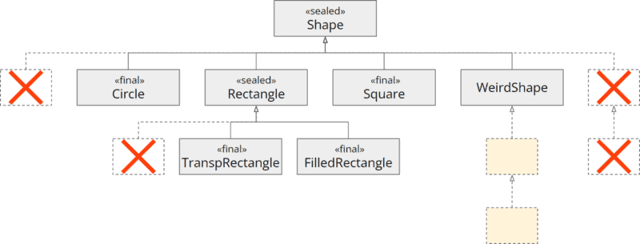
Sealed Class
The following class diagram shows the constraints added by sealed and permits:
Restricting the class hierarchy with "sealed" and "permits"

Slide 23
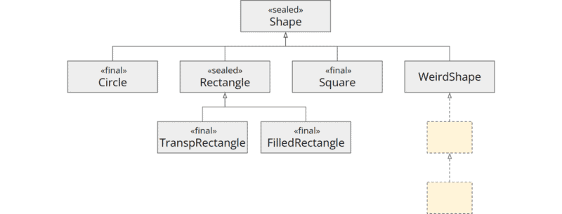
Sealed Class
For the sake of clarity, once more without the crossed-out classes:
Restricting the class hierarchy with "sealed" and "permits"
Notes:
It looks like we have reached our goal. But one step is still missing…

Slide 24
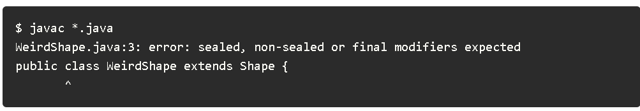
Opening the Sealed Class Hierarchy with "non-sealed"
With the changes made so far, our code looks like this:
public sealed class Shape permits Circle, Square, Rectangle, WeirdShape { ... }
public final class Circle extends Shape { ... }
public sealed class Rectangle extends Shape permits TranspRectangle, FilledRectangle { ... }
public final class Square extends Shape { ... }
public class WeirdShape extends Shape { ... }
public final class TranspRectangle extends Rectangle { ... }
public final class FilledRectangle extends Rectangle { ... }
When we try to compile this code, we get the following error message:

Slide 25
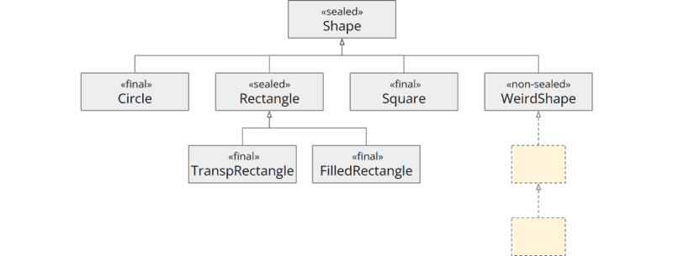
Opening the Sealed Class Hierarchy with "non-sealed"
For preventing accidental openings of the sealed class hierarchy, all classes must be marked sealed, non-sealed, or final.
Our WeirdShape class should be extensible, i.e., the sealing should be opened at this class. Therefore we have to mark this class as non-sealed:
public non-sealed class WeirdShape extends Shape { ... }

Slide 26
Particularities
There are some particularities to keep in mind when using sealed class hierarchies.
Sealing within a "Compilation Unit“
Local Classes
instanceof Tests with Sealed Classes

